Slide 1
Image Morphing
By: Nicholas Tylek

Slide 2
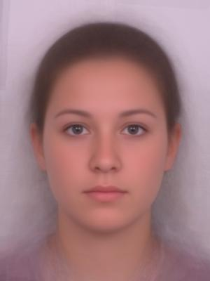
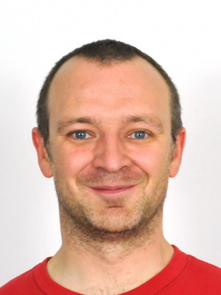
Images

Slide 3
Cross-Dissolve Attempt

Slide 4
Cross-Dissovle vs. Morphing
Cross-Dissolve has intermediate pixel values and combines them for each frame
ImageFrame = (1-frame_rate)*Image1 + frame_rate*image2
Morphing needs to have the objects change as well.
The object needs to be transformed.
Then the warped images can be combined with cross-dissolve

Slide 5
Step 1: control Points
Use cpSelect() function to select the points for both images.
Must have corresponding points.
Create image mesh with triangles
Use DelaunayTriangulation() to create non-overlapping triangles
Now the control points are ready to be morphed

Slide 6
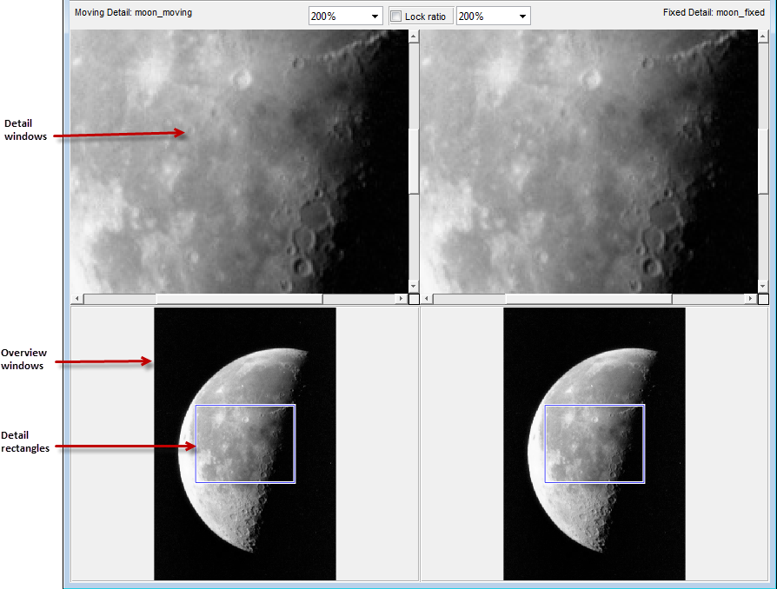
Step 1: control Points
cpSelect() 40 were selected

Slide 7
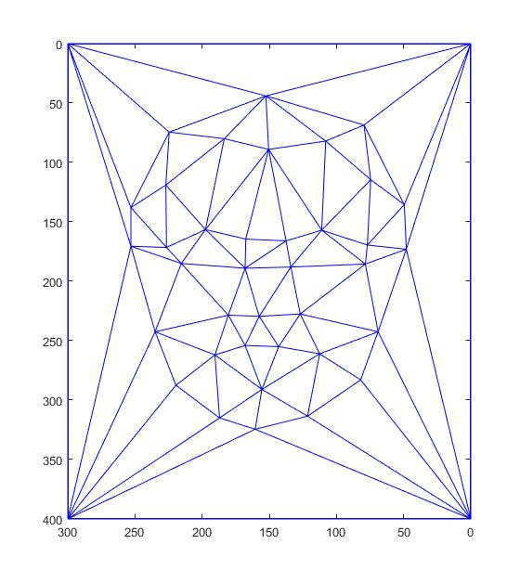
Step 2: Delaunay
imagePoints =(image1Points + image2Points)/2;
DT = delaunayTriangulation(imagePoints);

Slide 8
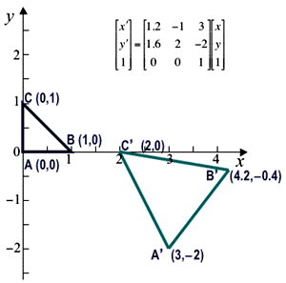
Step 3: Affine transform Triangles
Find Intermediate Points
IntermediatePoint = (1-a)*Image1Point+a*Image2Point
Use Affine Transform for each triangle
Interpolate
FinalMorphFrame = (1-a)*image1Warped + a*image2Warped;

Slide 9
Morphed Image

